Slide 1
Agenda
Day 3 | Instance Based Learning: Introduction, K-nearest neighbor learning, locally weighted regression, radial basis function, cased based reasoning. Reinforced Learning: Introduction, Learning Task, Q Learning
Source Code
https://github.com/profthyagu

Slide 2
1.1 Instance Based Learning
Memory-based learning (also called instance-based learning) is a type of learning algorithm that compares new test data with training data in order to solve the given machine learning problem. Such algorithms search for the training data that are most similar to the test data and make predictions based on these similarities.
Learning in these algorithms consists of simply storing the presented training data. When a new query instance is encountered a set of similar related instances is retrieved from memory and used to classify the new query instance
Examples : k-nearest neighbor learning , locally weighted regression, Radial Basis function (RBF), kernel machines and Case based Reasoning .

Slide 3
Instance based learning
Key idea: In contrast to learning methods that construct a general, explicit description of the target function when training examples are provided, instance-based learning constructs the target function only when a new instance must be classified.
Only store all training examples where x describes the attributes of each instance and f(x) denotes its class (or value).
Use a Nearest Neighbor method:
Given query instance ,
first locate nearest (most similar) training example ,
then estimate

Slide 4
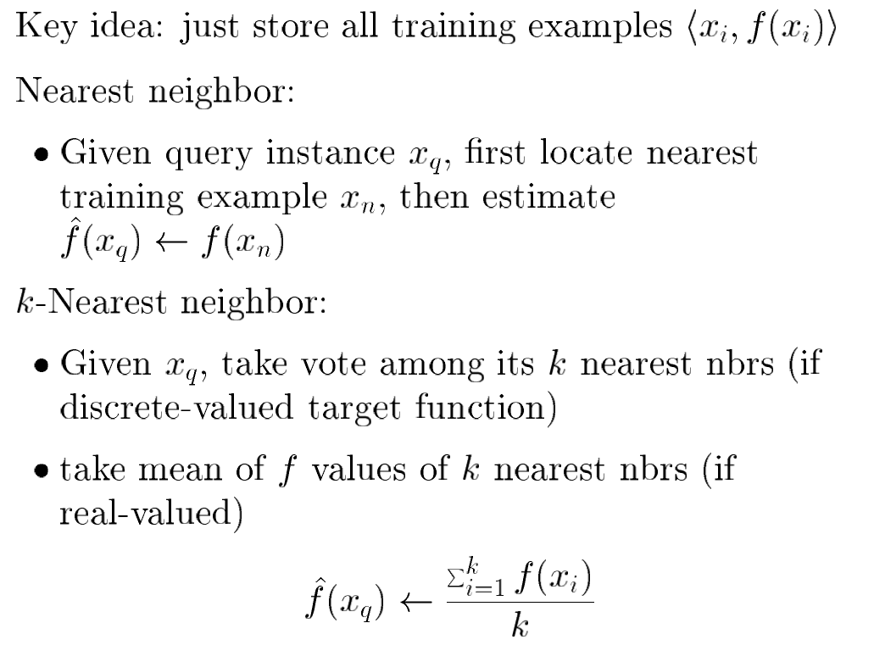

Slide 5
Example
Simple 2-D case, each instance described only by two values (x, y co-ordinates). The class is either or
Need to consider :
1) Similarity (how to calculate distance)
2) Number (and weight) of similar (near) instances

Slide 6
Similarity: Euclidean distance, more precisely let an arbitrary instance x be described by the feature vector (set of attributes) as follows:
where ar(x) denotes the value of the r^{th} attribute of instance x. Then the distance between two instances xi and xj is defined to be d(x_{i}, x_{j}) where

Slide 7
k-Nearest Neighbor:
Given query instance , take vote among its k nearest neighbors to decide its class, (return most common value of f among the k nearest training elements to )
Simple-NN, class is , 5-NN, class is
Advantage: overcome class noise in training set.

Slide 8
Key Advantages
Instead of estimating the target function once for the entire data set (which can lead to complex and not necessarily accurate functions) IBL can estimate the required function locally and differently for each new instance to be classified.
Algorithms for K-NN
Consider, the case of learning a discrete-valued target function of the
form
Training Algorithm
For each training example <x , f(x) >,
add the example to the list of training_examples

Slide 9
The K-NN algorithm for approximating a discrete valued function
Consider, the case of learning a discrete-valued target function of the
form
Training Algorithm :
For each training example <x , f(x) >, add the example to the list of training_examples
Classification Algorithm
Given a query instance xq to be classified
Let x₁ … x_{k} denote the k instances from training_examples that are nearest to x_{q}
Return
where argmax f(x) returns the value of x which maximises f(x),
e.g.

Slide 10
Lazy vs Eager Learning
The K-NN method does not form an explicit hypothesis regarding the target classification function. It simply computes the classification for each new query instance as needed.
Implied Hypothesis: the following diagram (Voronoi diagram) shows the shape of the implied hypothesis about the decision surface that can be derived for a simple 1- NN case.
The decision surface is a combination of complex polyhedra surrounding each of the training examples.
For every training example, the polyhedron indicates the set of query points whose classification will be
completely determined by that training example.

Slide 11
Continuous vs Discrete valued functions (classes)
K-NN works well for discrete-valued target functions. Furthermore, the idea can be extended f or continuos (real) valued functions. In this case we can take mean of the f values of k nearest neighbors:

Slide 12
When To Consider Nearest Neighbor ?
Instances map to points in
Average number of attributes (e.g. Less than 20 attributes per instance)
Lots of training data
When target function is complex but can be approximated by separate local simple approximations
Note that efficient methods do exist to allow fast querying (kd-trees)

Slide 13
Distance-weighted k-NN
Might want to weigh nearer neighbors more heavily
and d (x_{q} , x _{i}) is distance between x_{q} and x_{i}
For continuous functions:
Note now it may make more sense to use all training examples instead of just k.

Slide 14
Curse of Dimensionality
Imagine instances described by 20 attributes, but only 2 are relevant to target function: Instances that have identical values for the two relevant attributes may nevertheless be distant from one another
in the 20-dimensional space.
Curse of dimensionality: nearest neighbor is easily misled when high-dimensional X. (Compare to decision trees).
One approach: Weight each attribute differently (Use training)
1) Stretch j ^{th} axis by weight z_{j} , where z₁, …., z_{n} chosen to minimize prediction error
2) Use cross-validation to automatically choose weights z₁, …., z_{n}
3) Note setting z_{j} to zero eliminates dimension i altogether

Slide 15
Lab Program
Write a program to implement k-Nearest Neighbour algorithm to classify the iris data set. Print both correct and wrong predictions. Python ML library classes can be used for this problem.

Slide 16
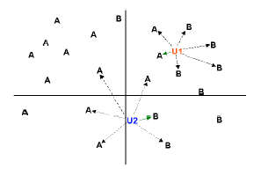
K-Nearest-Neighbor Algorithm
Principle: points (documents) that are close in the space belong to the same class

Slide 17

Definition of Nearest Neighbor
K-nearest neighbors of a record x are data points that have the k smallest distance to x

Slide 18
Nearest Neighbor Classification
Compute distance between two points:
Euclidean distance

Slide 19
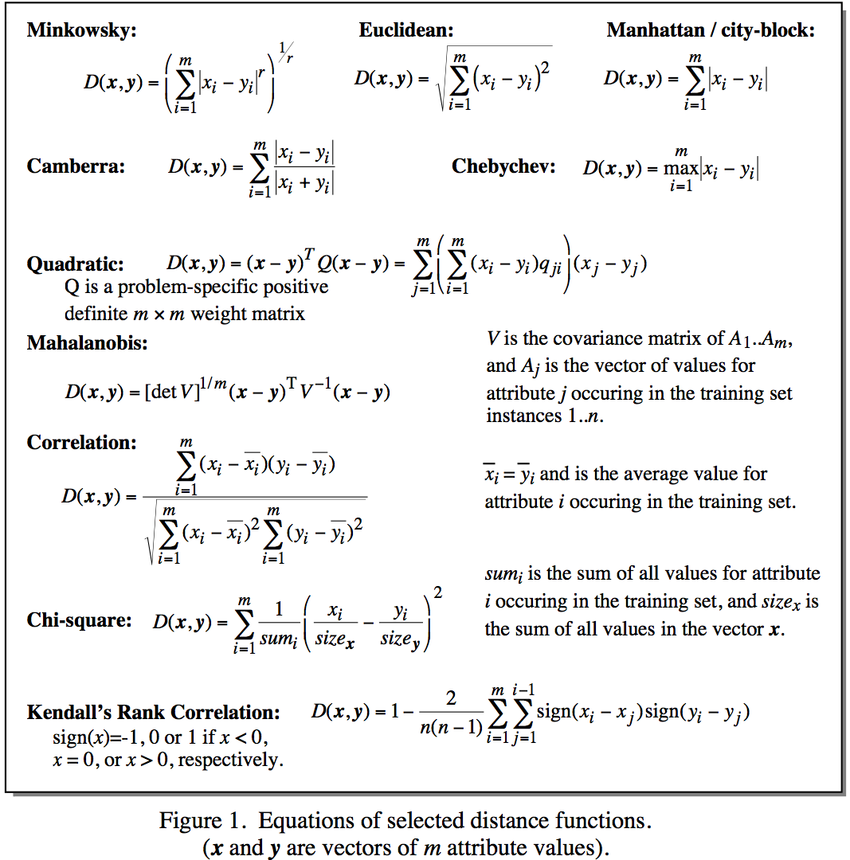
Distance Metrics
Notes:
Minkowsky = l-norm

Slide 20
Selection of Distance Metrics
You can choose the best distance metric based on the properties of your data. If you are unsure, you can experiment with different distance metrics and different values of K together and see which mix results in the most accurate models.
Euclidean is a good distance measure to use if the input variables are similar in type (e.g. all measured widths and heights).
Manhattan distance is a good measure to use if the input variables are not similar in type (such as age, gender, height, etc.).

Slide 21
Nearest Neighbor Classification…
Choosing the value of k:
If k is too small, sensitive to noise points
If k is too large, neighborhood may include points from other classes

Slide 22
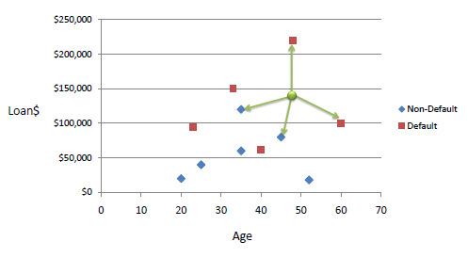
Example: Consider the following data concerning credit default. Age and Loan are two numerical variables (predictors) and Default is the target.

Slide 23
Example: We can now use the training set to classify an unknown case (Age=48 and Loan=$142,000) using Euclidean distance. If K=1 then the nearest neighbor is the last case in the training set with Default=Y.
D = Sqrt[(48-33)^2 + (142000-150000)^2] = 8000.01 >> Default=Y

Slide 24
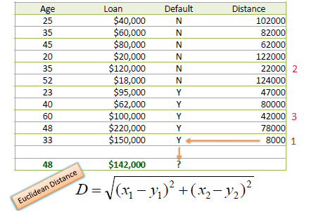
With K=3, there are two Default=Y and one Default=N out of three closest neighbors. The prediction for the unknown case is again Default=Y.

Slide 25
Source Code

Slide 26
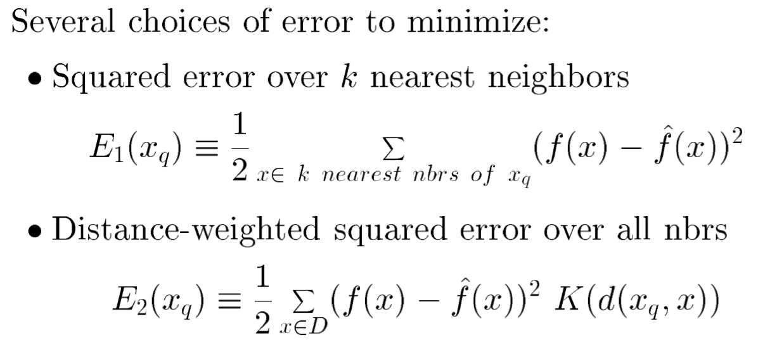
1.2 Locally-weighted Regression
Basic idea: k-NN forms local approximation to f for each query point xq
Why not form an explicit approximation f (x) for region surrounding xq
Fit linear function to k nearest neighbors
Fit quadratic, ...
Thus producing ``piecewise approximation'' to f

Slide 27
f1 (simple regression)
Locally-weighted regression
f2
Locally-weighted regression
f3
Locally-weighted regression
f4
Training data
Predicted value using simple regression
Predicted value using locally weighted (piece-wise) regression

Slide 28
Lab Program 8
Implement the non-parametric Locally Weighted Regression (LOWESS) algorithm in order to fit data points. Select appropriate data set for your experiment and draw graphs.

Slide 29
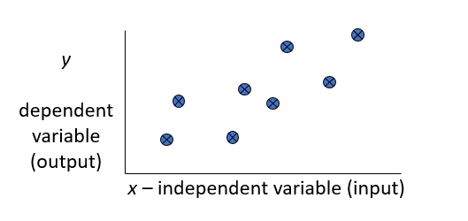
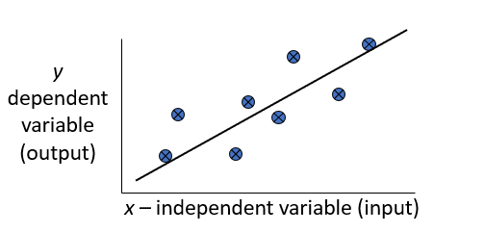
Regression
Regression is a technique from statistics that is used to predict values of a desired target quantity when the target quantity is continuous .
In regression, we seek to identify (or estimate) a continuous variable y associated with a given input vector x.
y is called the dependent variable.
x is called the independent variable.

Slide 30
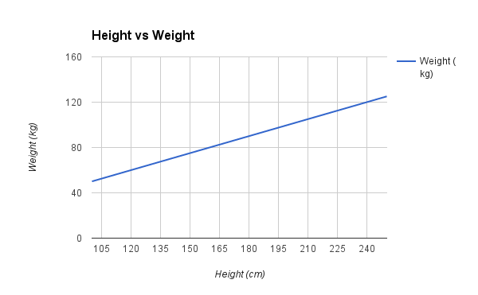
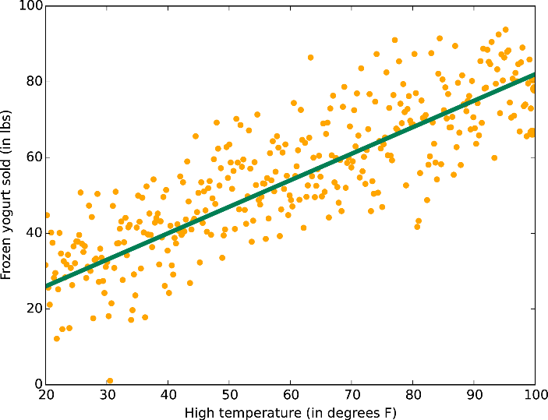
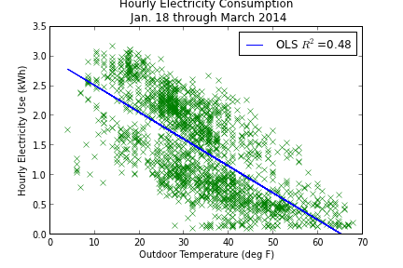
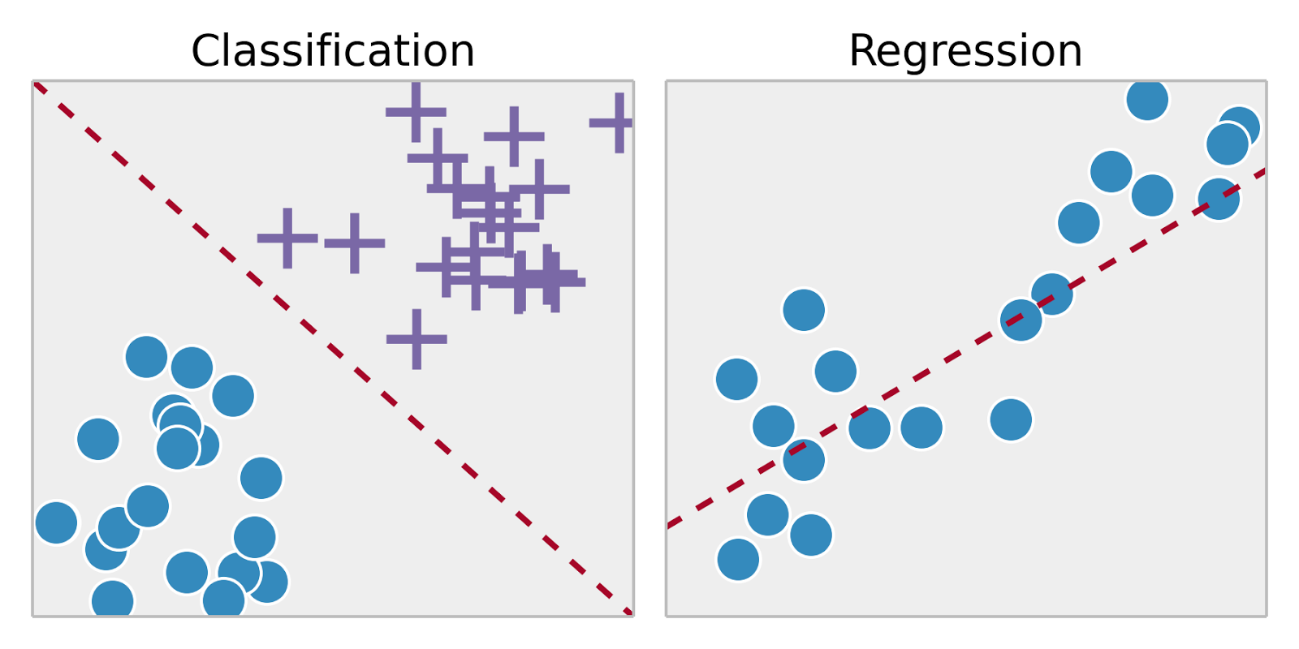

Slide 31
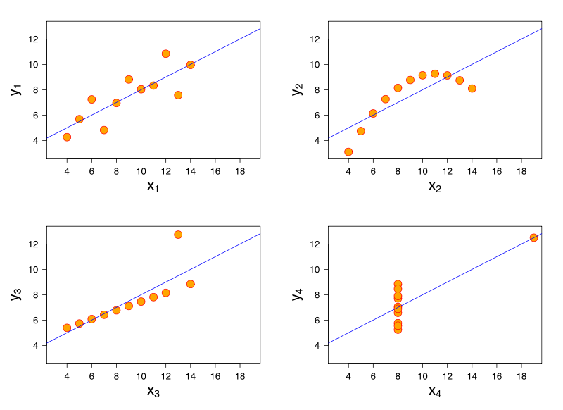
What lines "really" best fit each case?

Slide 32
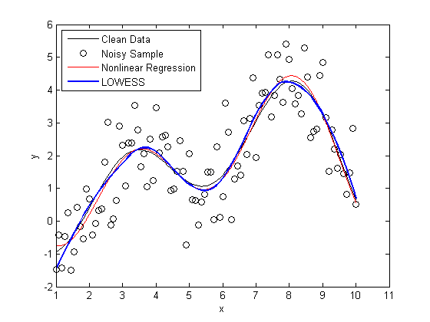
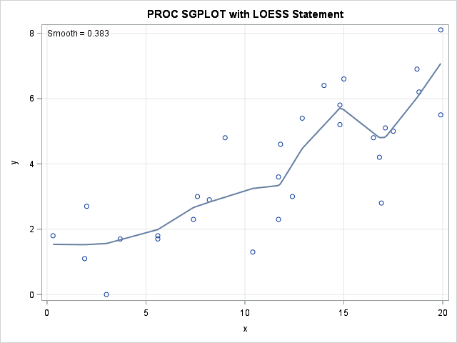
Loess/Lowess Regression
Loess regression is a nonparametric technique that uses local weighted regression to fit a smooth curve through points in a scatter plot.

Slide 33


Lowess Algorithm
Locally weighted regression is a very powerful non-parametric model used in statistical learning .Given a dataset X, y, we attempt to find a model parameter β(x) that minimizes residual sum of weighted squared errors. The weights are given by a kernel function(k or w) which can be chosen arbitrarily .
Algorithm
Read the Given data Sample to X and the curve (linear or non linear) to Y
Set the value for Smoothening parameter or Free parameter say τ
Set the bias /Point of interest set X0 which is a subset of X
Determine the weight matrix using :
Determine the value of model term parameter β using :
Prediction = x0*β

Slide 34
Source Code

Slide 35

1.3 Radial basis Function Networks
One approach to function approximation that is closely related to distance weighted regression and also to artificial neural network its learning with radial basis functions .It is eager instead of lazy
Global approximation to target function in terms of linear combination of local approximations
Used e.g. for image classification
In this approach the learned hypothesis is a function of the form

Slide 36
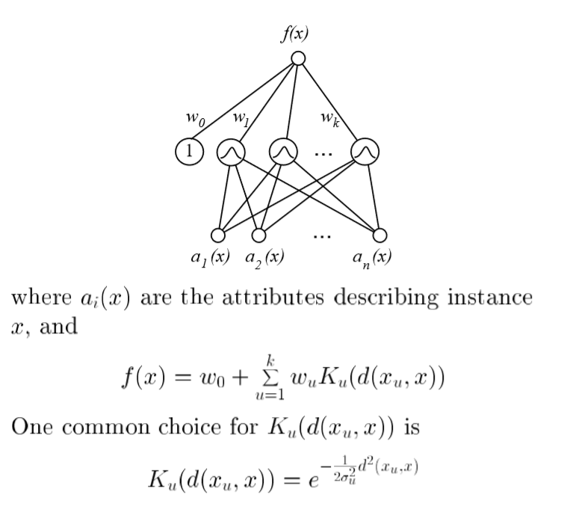

Slide 37

Training of RBF network
Given a set of training examples of the target function, RBF networks are typically trained in a two-stage process.
First, the number k of hidden units is determined and each hidden unit u is defined by choosing the values of xu and σu^2: that define its kernel function K,(d(x,, x)).
Second, the weights w, are trained to maximize the fit of the network to the training data, using the global error criterion given by Equation
Because the kernel functions are held fixed during this second stage, the linear weight values w, can be trained very efficiently.

Slide 38
1.4 Case Based Reasoning
Instance-based methods such as k-NEAREST NEIGHBOUR and locally weighted regression share three key properties.
First, they are lazy learning methods in that they defer the decision of how to generalize beyond the training data until a new query instance is observed.
Second, they classify new query instances by ana- lyzing similar instances while ignoring instances that are very different from the query.
Third, they represent instances as real-valued points in an n-dimensional Euclidean space
Case-based reasoning (CBR) is a learning paradigm based on the first two of these principles, but not the third

Slide 39
Case Based Reasoning
In CBR, instances are typically represented using more rich symbolic descriptions, and the methods used to retrieve similar instances are correspondingly more elaborate.
CBR has been applied to problems such as conceptual design of mechanical devices based on a stored library of previous designs (Sycara et al. 1992), reasoning about new legal cases based on previous rulings (Ashley 1990), and solving planning and scheduling problems by reusing and combining portions of previous solutions to similar problems (Veloso 1992).

Slide 40
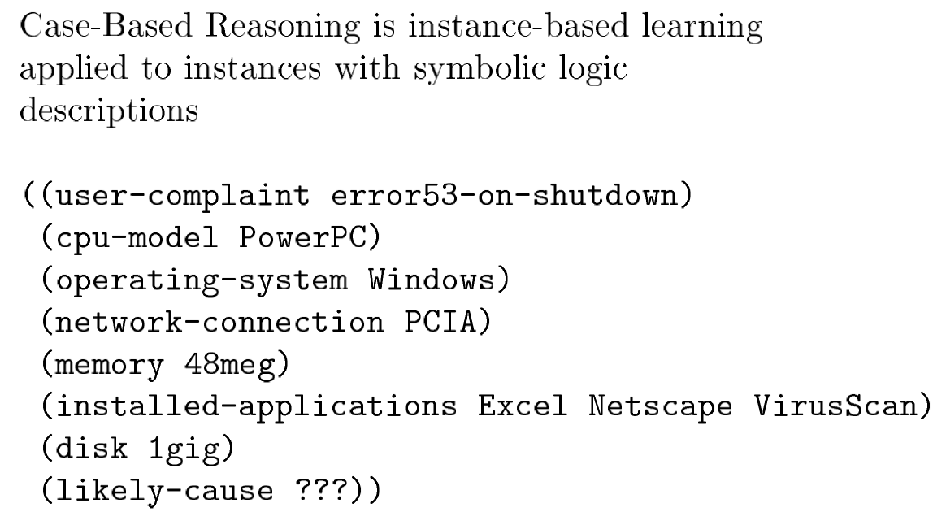
Case Based Reasoning

Slide 41
Case Based Reasoning in CADET
The CADET system (Sycara et al. 1992) employs case- based reasoning to assist in the conceptual design of simple mechanical devices such as water faucets.
It uses a library containing approximately 75 previous designs and design fragments to suggest conceptual designs to meet the specifications of new design problems.
Each instance stored in memory (e.g., a water pipe) is represented by describing both its structure and its qualitative function.
New design problems are then presented by specifying the desired function and requesting the corresponding structure.

Slide 42
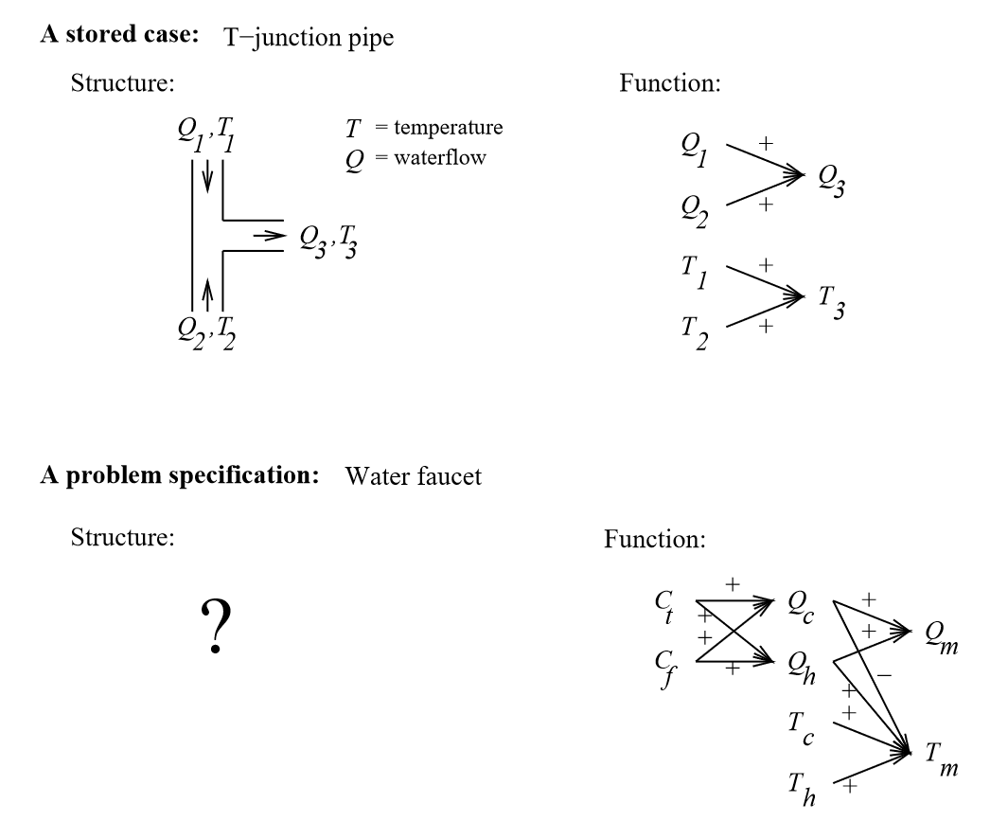
Case Based Reasoning in CADET

Slide 43
The top half of the figure shows the description of a typical stored case called a T-junction pipe. Its function is represented in terms of the qualitative relationships among the waterflow levels and temperatures at its inputs and outputs.
In the functional description at its right, an arrow with a "+" label indicates that the variable at the arrowhead increases with the variable at its tail.
For example, the output waterflow Q3 increases with increasing input waterflow Ql.
Similarly a "-" label indicates that the variable at the head decreases with the variable at the tail.

Slide 44
The bottom half of this figure depicts a new design problem described by its desired function. This particular function describes the required behavior of one type of water faucet.
Here Qc, refers to the flow of cold water into the faucet, Qh to the input flow of hot water, and Qm, to the single mixed flow out of the faucet.
Similarly, Tc, Th, and Tm , refer to the temperatures of the cold water, hot water, and mixed water respectively.
The variable Ct, denotes the control signal for temperature that is input to the faucet, and Cf denotes the control signal for waterflow. Note the description of the desired function specifies that these controls Ct, and Cf are to influence the water flows Qc, and Qh, thereby indirectly influencing the faucet output flow Qm, and temperature Tm.

Slide 45
Given this functional specification for the new design problem, CADET searches its library for stored cases whose functional descriptions match the design problem.
If an exact match is found, indicating that some stored case implements exactly the desired function, then this case can be returned as a suggested solution to the design problem.
If no exact match occurs, CADET may find cases that match various subgraphs of the desired functional specification.

Slide 46
Generic properties of case-based reasoning system
Instances or cases may be represented by rich symbolic descriptions, such as the function graphs used in CADET. This may require a similarity metric different from Euclidean distance, such as the size of the largest shared subgraph between two function graphs.

Slide 47
Generic properties of case-based reasoning system
Multiple retrieved cases may be combined to form the solution to the new problem.
This is similar to the k-NEAREST NEIGHBOR approach, in that multiple similar cases are used to construct a response for the new query.
However, the process for combining these multiple retrieved cases can be very different, relying on knowledge-based reasoning rather than statistical methods.

Slide 48
Generic properties of case-based reasoning system
There may be a tight coupling between case retrieval, knowledge-based reasoning, and problem solving.
One simple example of this is found in CADET, which uses generic knowledge about influences to rewrite function graphs during its attempt to find matching cases.
Other systems have been developed that more fully integrate case-based reasoning into general search- based problem-solving systems. Two examples are ANAPRON (Golding and Rosenbloom 199 1) and PRODIGY/ANALOGY (Veloso 1992).

Slide 49
Summary
To summarize, case-based reasoning is an instance-based learning method in which instances (cases) may be rich relational descriptions and in which the retrieval and combination of cases to solve the current query may rely on knowledge- based reasoning and search-intensive problem-solving methods.
One current re- search issue in case-based reasoning is to develop improved methods for indexing cases. The central issue here is that syntactic similarity measures (e.g., subgraph isomorphism between function graphs) provide only an approximate indication of the relevance of a particular case to a particular problem.

Slide 50
2. Reinforced Learning
Reinforcement learning addresses the question of how an autonomous agent that senses and acts in its environment can learn to choose optimal actions to achieve its goals.
This very generic problem covers tasks such as learning to control a mobile robot, learning to optimize operations in factories, and learning to play board games. Each time the agent performs an action in its environment, a trainer may provide a reward or penalty to indicate the desirability of the resulting state.
For example, when training an agent to play a game the trainer might provide a positive reward when the game is won, negative reward when it is lost, and zero reward in all other states. The task of the agent is to learn from this indirect, delayed reward, to choose sequences of actions that produce the greatest cumulative reward. This chapter focuses on an algorithm called Q learning that can acquire optimal control strategies from delayed rewards, even when the agent has no prior knowledge of the effects of its actions on the environment. Reinforcement learning algorithms are related to dynamic programming algorithms frequently used to solve optimization problems.

